Slide 1
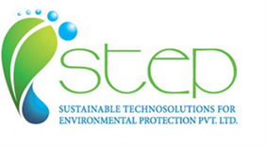
DGC (DOWNFLOW GAS CONTACTOR) Technology: A Novel Reactor for Effluent Treatment, Biogas Upgradation and Chemical Reactions
STEP Pvt. Ltd.

Slide 2

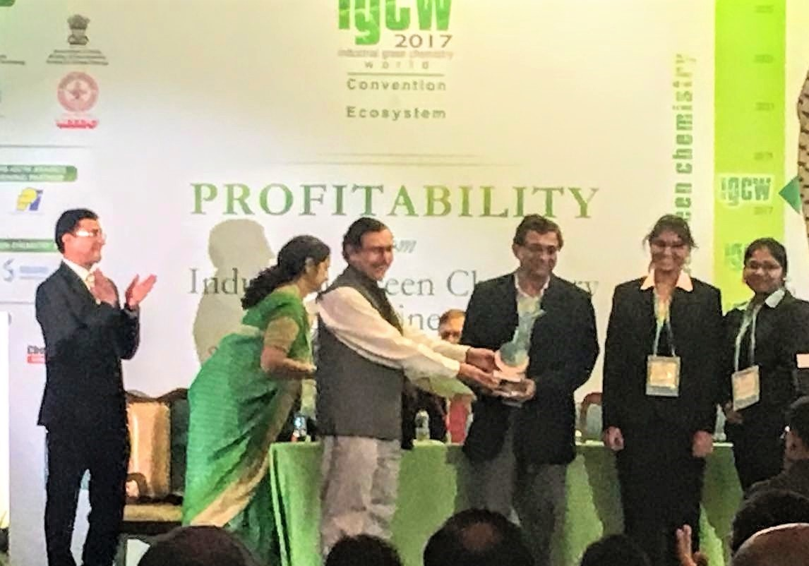
DGC- Award & Recognitions
World Alliance Solution- Solar Impulse is supported by UNESCO, World Bank, UN Environment and few other global institutions.
DGC technology has been selected by WAS as an Efficient Solution in September 2019, with an overall Impact rating of 3.3 (out of 4) and Economic Profitability Rating of 3.5.
DGC technology won the SERB-IGCW 2017 award for Green Technology in the small-scale company category at IGCW 2017 conference in Mumbai in October 2017.

Slide 3
Current Status- Commercialization
Effluent Treatment
One customer has confirmed order for pilot plant, which will be set up in Q2 2020
Another company is evaluating to set up a pilot plant.
Chemical Reaction-
First order for commercial plant received. Will be set-up in Q2 2020.
In discussion with another company for chlorination reaction
Biogas Upgradation-
- Established technology to produce 99+% methane on 50 m3/hr plant. Currently finetuning complete process including regeneration & recycle of solvent.

Slide 4
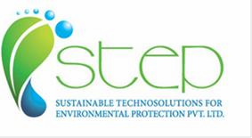





DGC Technology- Background
DGC Technology was developed by professors at Birmingham University in UK in 1980s/90s.
Professors involved in the technology formed a company in 2002- WRK Design & Services Ltd.
WRK has worked on various sponsored projects since 2002 and has demonstrated effectiveness of DGC technology in various applications.
Three key areas of applications are - effluent treatment, biogas upgradation (CO2 capture) and gas-liquid reactions
STEP has signed an agreement with WRK in 2014 to develop DGC technology at commercial level in Asia- Pacific
Snowtech Equipment Pvt Ltd, Navi Mumbai is the partner for effluent treatment application and United Envirotech Pvt. Ltd is partner for Biogas Upgradation technology.
.
.
.
.
Our Principal
Our Partners

Slide 5
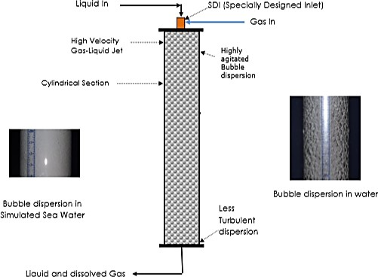
DGC Technology
DGC is downflow co-current device used for efficient mass transfer
It consist of a cylindrical section with a Specially Designed Inlet (SDI) at its entry (at the top), allowing both liquid and gas into the reactor
SDI is the heart of the technology.
High velocity liquid input through the entry section (SDI) generates intense shear & energy which produces highly agitated gas-liquid dispersion with increased interfacial area and improved mass transfer.
DGC can be operated at high pressure & temperature; and in batch & continuous mode.
Important feature: Air for effluent treatment can sucked in from the atmosphere eliminating use of air compressor.
100 %

Slide 6









DGC Advantages vs. Conventional Reactors
Lower Power Consumption
Smaller footprint
100 % Gas
Utilization
High Gas Hold up: 40-
50 %
High interfacial areas
No internal moving parts
Lower Capital & Operating costs
Inherently safe operating conditions

Slide 7

Key Applications of DGC
Gas absorption viz. Biogas Upgradation to remove CO2; and desulfurization (H2S removal) from biogas & petrochemical streams
Effluent treatment- Reduce Chemical Oxygen Demand (COD) & Biological Oxygen Demand (BOD), Total Ammonical Nitrogen (TAN) and Phenols. From effluent streams
Gas-Liquid and Liquid-Liquid Chemical Reactions for manufacturing of chemicals
Cooling Tower Water treatment (New area to be developed)-Eliminate microbial growth and scaling could be delayed/managed
Key Applications

Slide 8

Effluent Treatment

Slide 9
Effluent Treatment- WRK Experience
WRK has completed various projects and found that DGC can be used efficiently in effluent treatment of industrial waste, land-filled leachates, dairy waste and sewage.
DGC reduced COD/ BOD in effluent streams successfully, over a period of time.
It can be operated with air/ oxygen/ ozone/ H2O2/ UV/ UV + a catalyst (Titanium Dioxide, TiO2), individually or in combination
Photocatalytic process (UV + TiO2) can breakdown “difficult” pollutants as seen from the trials on some of the effluents.

Slide 10

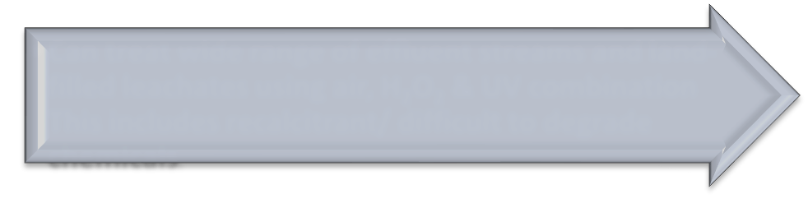



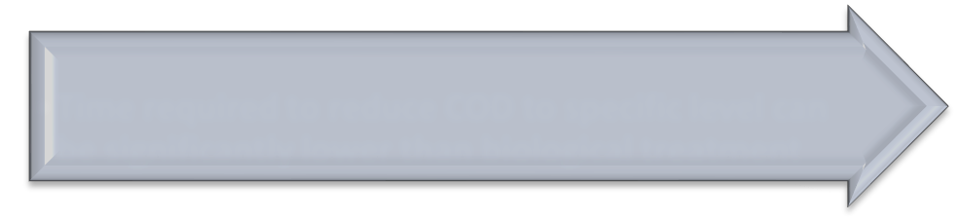




Advantages over Competitive Technologies
Versatility
Can treat wide range of effluent streams and land filled leachates using air, H2O2 and UV combination. This includes recalcitrant/difficult to degrade chemicals.
Characteristic
COD/BOD can be reduced in presence of high TDS. Effluent containing phenols & nitrogenous chemicals can also be treated.
Shorter Treatment Time
Time required to reduce COD to specific level can be significantly lower than biological treatment
Smaller Footprint
Due to compact size, it is useful for small scale companies, which have space constraint
Lower Operating Cost
As air is sucked in from atmosphere, air compressor is not required. Operating cost is mainly for pump + UV and H2O2, if used.

Slide 11
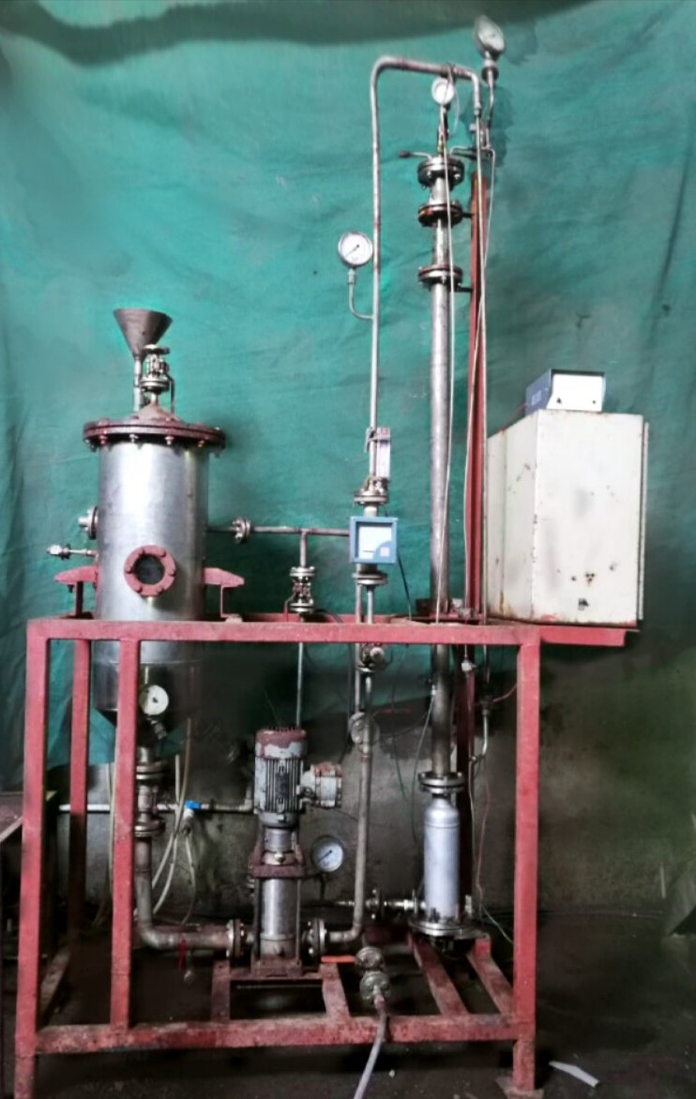
DGC-Skid Mounted Pilot Plant
SDI
DGC Column
Feed Vessel
UV section
Pump

Slide 12

Trials on Industrial Effluents
ST E P has conducted trials on more than 40 industrial effluent streams on DGC using air/ oxygen or combination of air, H₂O₂ & UV for COD/ BOD reduction. These effluents were from different Indian companies including a Common Effluent Treatment Plant (CETP). Some of the streams were known to be difficult to degrade as they contained phenols and nitrogen containing chemicals.

Slide 13
Results - Few Trials
Sr. No | Stream | Oxidants | Operated Hours | Reduction In Parameters (%) | Initial Values (ppm)
1. | CETP | Air | 6 to 8 | COD- 60 max, BOD- 40 max, TDS- 40 max | COD-2000, BOD-700, TDS- 11000
2. | MEE condensate (pharma) | Air, H₂O₂ & UV | 5 | COD- 49 max, TDS- 90 max, TAN- 36 max | COD-12950, TDS- 2300, TAN- 2870
3. | Speciality chemicals, sulphur containing stream | Air, H₂O₂ & UV | 8 | COD- 68 max, BOD- 70 max | COD- 6400, BOD- 3700, TDS-14000
4. | Phenols containing stream | Air, H₂O₂/ UV | 6 | COD- 54, BOD- 56, phenols- 60 | COD-24200, BOD-9600, TDS-25000, phenols-520
5. | Alcohol containing stream | Air & H₂O₂ | 4 | COD- 35 max, BOD- 35 max, TAN- 95 max | COD-7900, BOD- 3100, TAN -93
6 | Sulphate & Phosphate containing streams | Air & H₂O₂/UV | 8 | COD- 20 & 28, TDS – 17 & Nil | COD-171000, TDS-300000 & COD-32200, TDS- 137500
7 | Speciality & nitrogen containing Chemicals | Air & H₂O₂/ UV | 9 | COD- 47, BOD- 45, TAN- 60 | COD-110000, BOD-45000, TDS- 258000, TAN-6800
8 | Sugar condensate | Air | 4 | COD- 83 | COD- 3500
9 | Specialty Chemicals | Air | 6 | COD- 25, BOD- 27, TDS-11 | COD-376300, BOD-150000, TDS- 390000
10 | Speciality Chemicals containing phenol & nitrogen | Air+UV+H₂O₂ | 10 | COD- 36, Phenol- 33, TAN- 34 | COD- 10000, phenols- 400, TAN- 196
11 | Agro Chemicals | Air+ UV | 8 | COD-61%, TDS-11%, Cl-41%, SO4-16 % | COD- 20283, TDS-26487, Cl- 142, SO4-231000

Slide 14
Key Takeaways
DGC works well to degrade recalcitrant Chemicals.
It has ability to reduce COD/BOD even with high TDS (>100000 ppm)
It can be used as Standalone technology or in combination with Biological treatment.
Contact time is significantly lower and plant footprint is also smaller than biological reactor.
DGC can be employed in smaller companies which have space constraint.
For commercial plants, self-inducing SDI which sucks in requisite amount of air from atmosphere, will be used.
Capex and Opex will be competitive with conventional processes

Slide 15
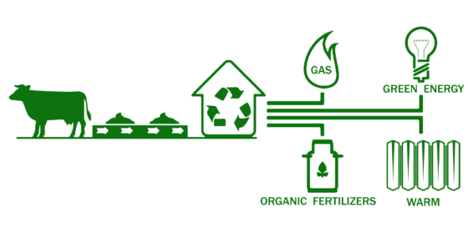
Biogas Upgradation

Slide 16
Background- WRK Technology
Biogas upgradation by removal of CO2 & H2S (Patent applied):
99+% absorption/ removal of CO2 and H2S
Methane concentration in the gas outlet > 98%
Proprietary absorbent solution used – ABSOLV, is water based
Biogas of improved quality with enhanced Calorific value
Significant cost savings for power generation. Removal of H2S allows increased plant longevity
Upgraded Biogas can be used as CNG fuel for transportation.
Recovery of absorbed CO2 from ABSOLV possible. ABSOLV can be recycled.
Set up a Plant for 50 m3/hr biogas in collaboration with United Envirotech Pvt. Ltd., Pune. Established the process for CO2 capture. Working on fine-tuning the process for regeneration and recycle of ABSOLV.

Slide 17
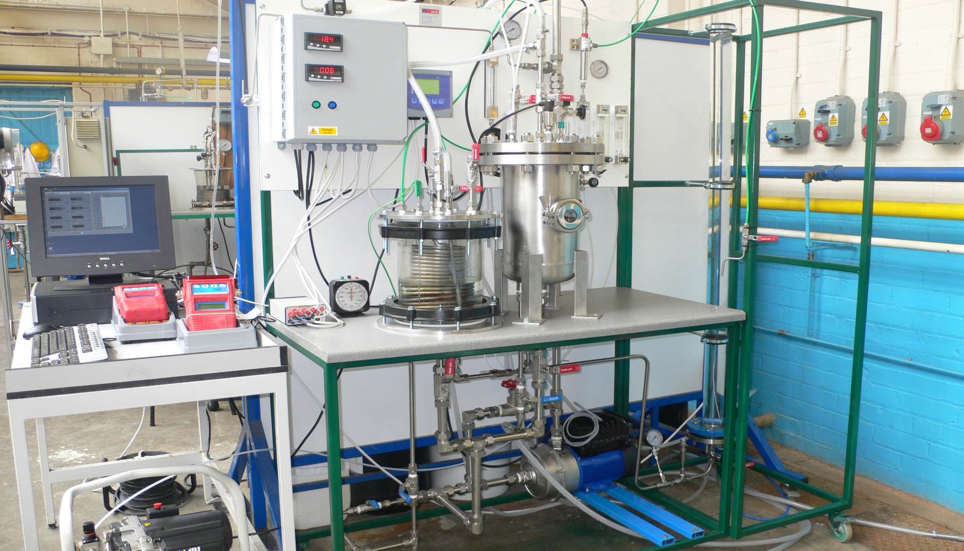
Carbon Capture- WRK Set-up
POWER CONTROL BOX
CO2-LIQ MONITOR
CO2-LIQUID PROBE
PC
CO2-GAS PROBE
DGC REACTOR
DATA LOGGER
GAS & LIQUID FLOWMETERS
SS RECEIVER-PRESSURE
CO2 – GAS DATA LOGGERS
GLASS RECEIVER-ATMOSPHERIC
PUMP
AIR COMPRESSOR
CO2 ABSORPTION DGC REACTOR UNIT

Slide 18
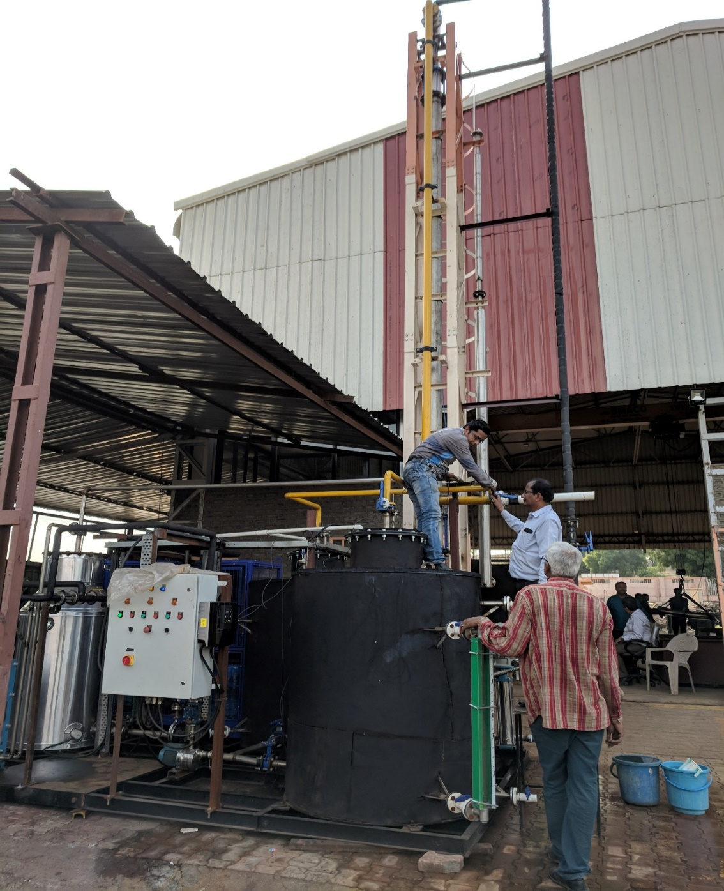
Biogas Upgradation Plant

Slide 19
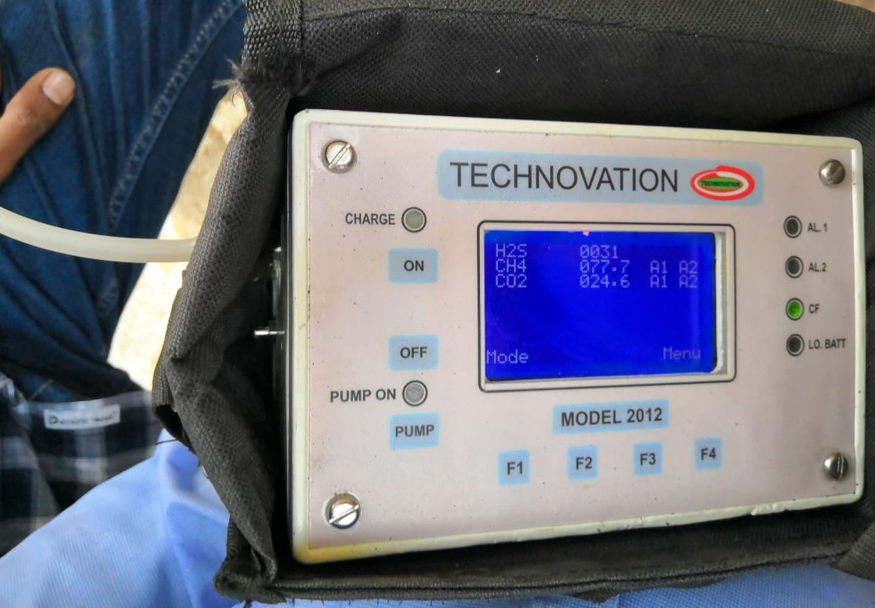
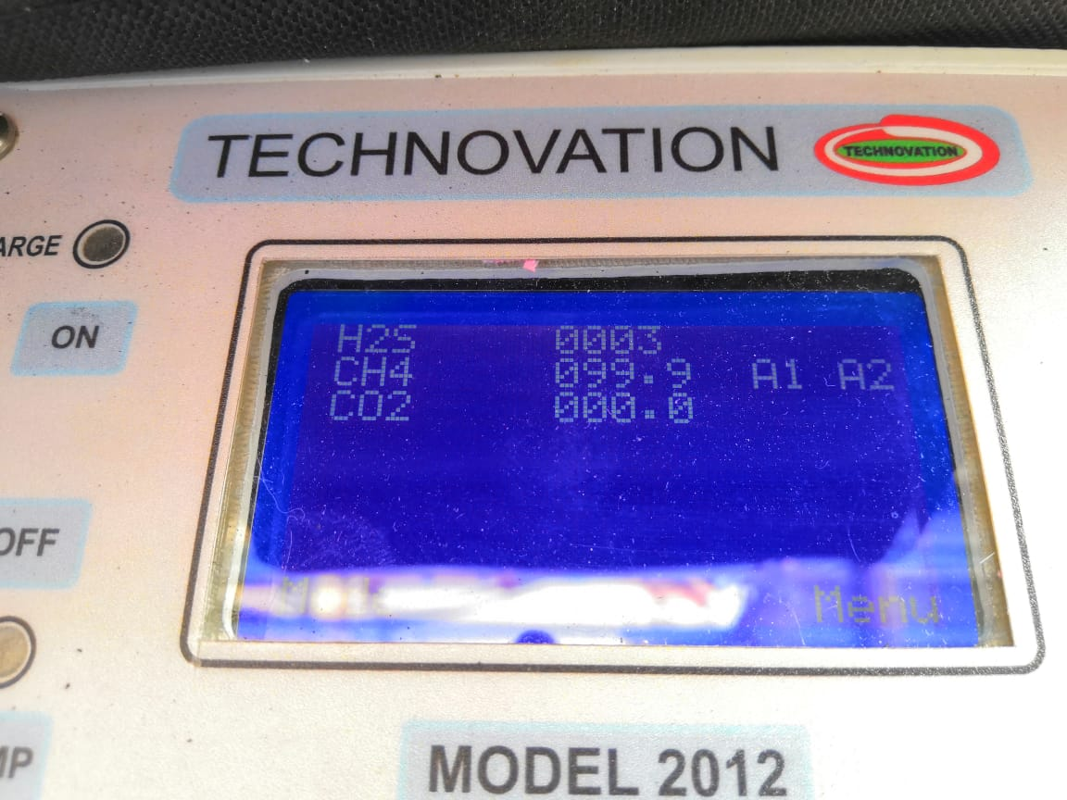
Biogas Upgradation Results
Biogas composition at inlet
Biogas composition at outlet

Slide 20
WRK Technology Advantages
Environmentally-friendly Absorption solvent-
Solvent used in the process is water containing specific salts.
It is proprietary formulation branded as ABSOLV.
Competing technologies use costly organic solvents or
membrane or water under high pressure.
Single Solvent
ABSOLV can capture and separate both CO2 and H2S present in Biogas in a single stage. With other technologies, CO2 and H2S are removed from Biogas in sequential process.
Plant Size
Most of current Biogas Upgrading technologies do not perform effectively below 50 m3/hr. DGC technology can be effective even for a small plant of 5 m3/hr. It can be scaled up to any large size plant.
Process Parameters
Competing technologies require either high pressure or high temperature to capture CO2/ H2S. WRK Technology can be operated at 20 to 25 C and atmospheric pressure. It can also be operated at higher pressures, if required, with better efficiency & effectiveness

Slide 21
.
WRK Technology- Advantages
Current Technologies | DGC Technology
pressure swing adsorption, amine absorption, water scrubbing, cryogenic and membrane separation, produce Biogas with 95 to 99% purity of methane | DGC technology can produce Biogas with improved quality (99+% methane
CO2 removal could be around 95 to 98%, | DGC technology, 99+% CO2 removal can be achieved.
Operated at higher pressure and temperature | Operated at room temperature and atmospheric pressure. If it operated at higher pressure & around 20 C-better efficiency & performance than at normal conditions
CAPEX for competing technology is higher | DGC based plant will cost 15-25% lower.
Opex –Similar or Higher | Opex is similar or could be lower than the competing technologies. 500 m3/hr plant’s power consumption would be < 0.1 KW/ m3 of biogas without CO2 recovery
CO2 Utilization- If required, captured CO2 can be recovered and utilised, or also converted into a useful product by use of a specific Absorption solution

Slide 22
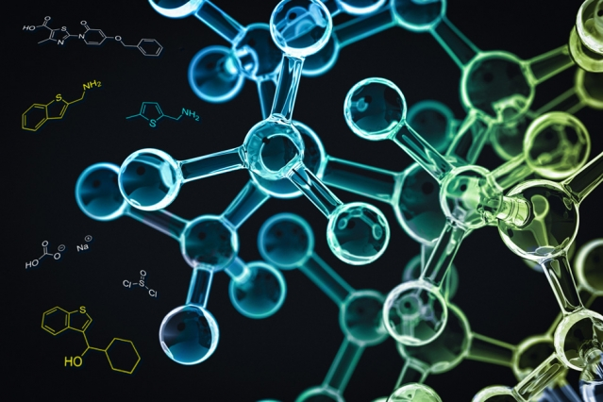
Chemical Reactions

Slide 23
DGC Technology Advantages
Faster reaction-
The mass/ gas transfer rates are higher than conventional reactors due to fine/ micro gas bubbles; hence the reaction will progress at much faster rate in DGC
Lower raw materials usage-
Raw materials used in a process could be reduced due to high mass transfer & reaction rates obtained in the DGC
Higher conversion & selectivity; lower waste-
Conversion and selectivity to main product could significantly improve, thereby reducing by-product & waste formation.
Continuous process-
Reaction can be carried out in continuous process, thereby improving the productivity and reducing utilities used.

Slide 24
Reactions on DGC
WRK has applied for UK patent for biodiesel production using DGC.
Pilot plant trials for oxidation reaction are in progress.The results indicate that the reactions occur in shorter time than conventional reactors and can improve the selectivity for desired product.
STEP will undertake projects from customer to demonstrate “proof of concept” for industrial gas-liquid reactions, which could be explored on DGC.
The DGC unit could be rented to companies with technical support from STEP for evaluating specific gas-liquid reactions.

Slide 25
Thank You

